Slide 1
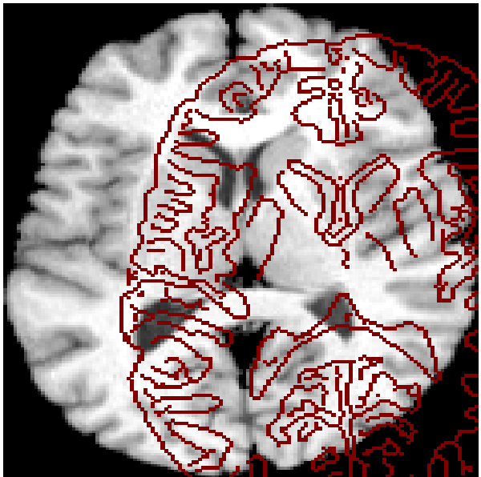
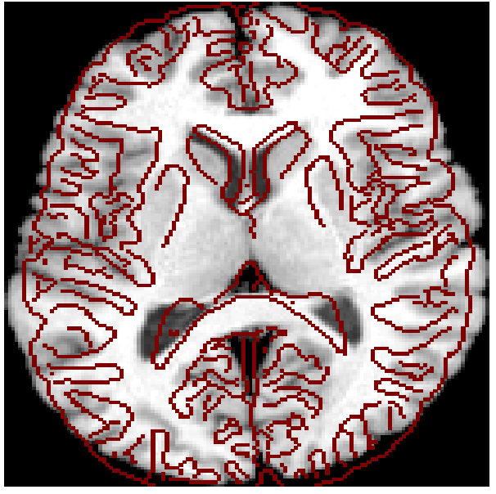
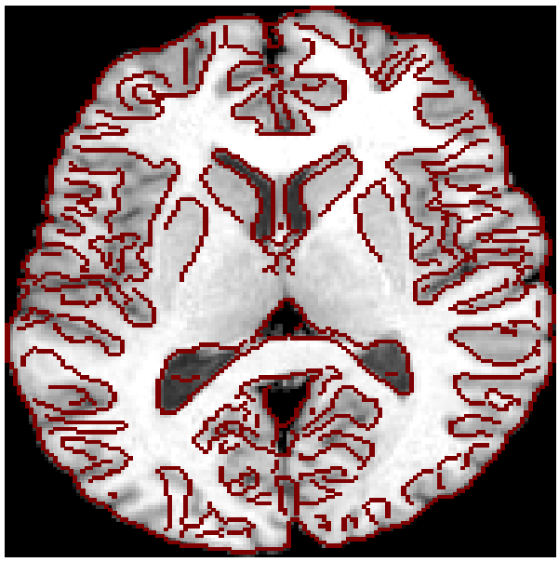
Image Registration
Is the process of finding the optimal transformation to maximize correspondence across images. Necessary components are:
Transformation model: defines the type of geometric transform to be used (e.g., rigid, affine which are linear, deformable which are non-linear or elastic).
Similarity metric: for registration basis measures the degree of alignment between images usually through measuring image intensity patterns (mutual information, cross-correlation, sum of squared intensity differences)
Optimization method: tries to maximize the similarity measure
Validation protocol

Slide 2
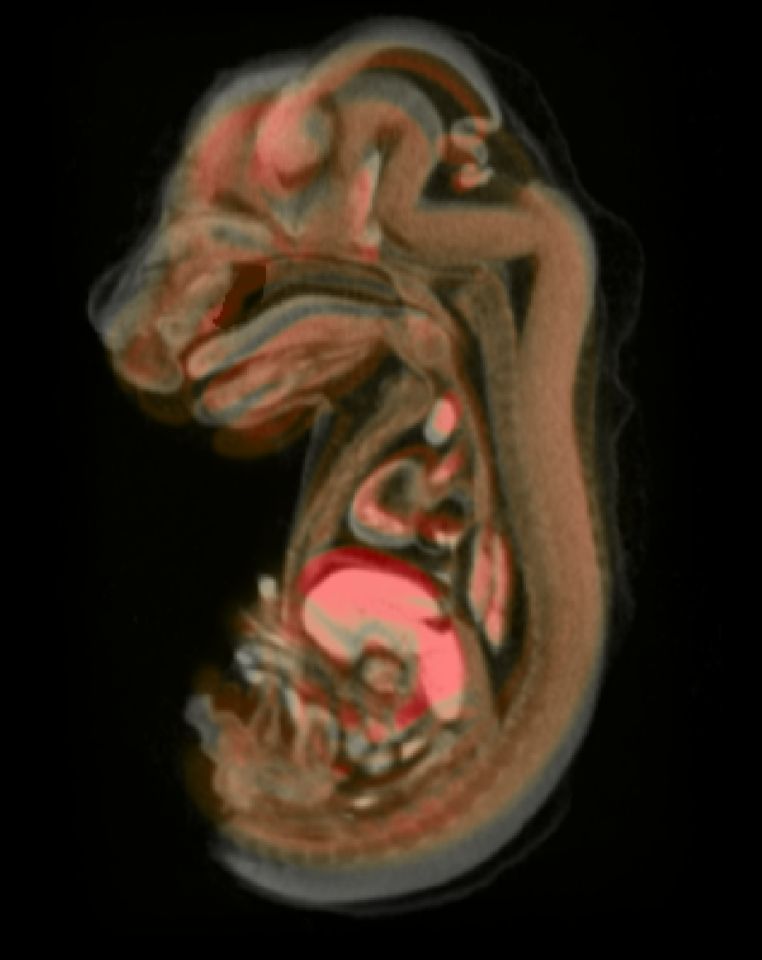
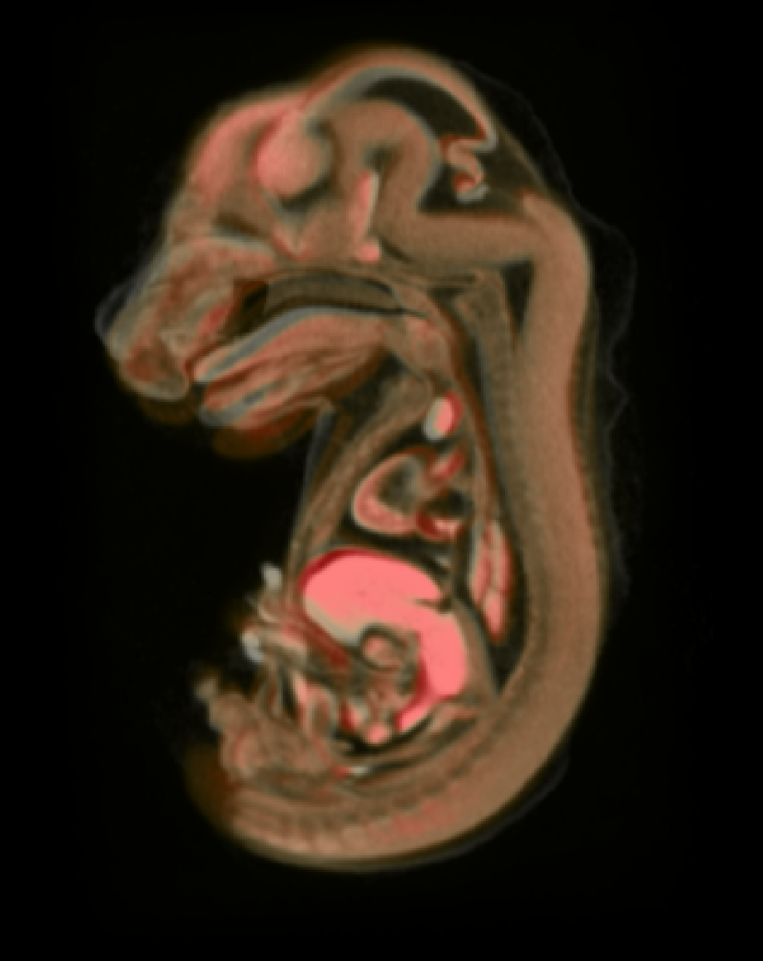
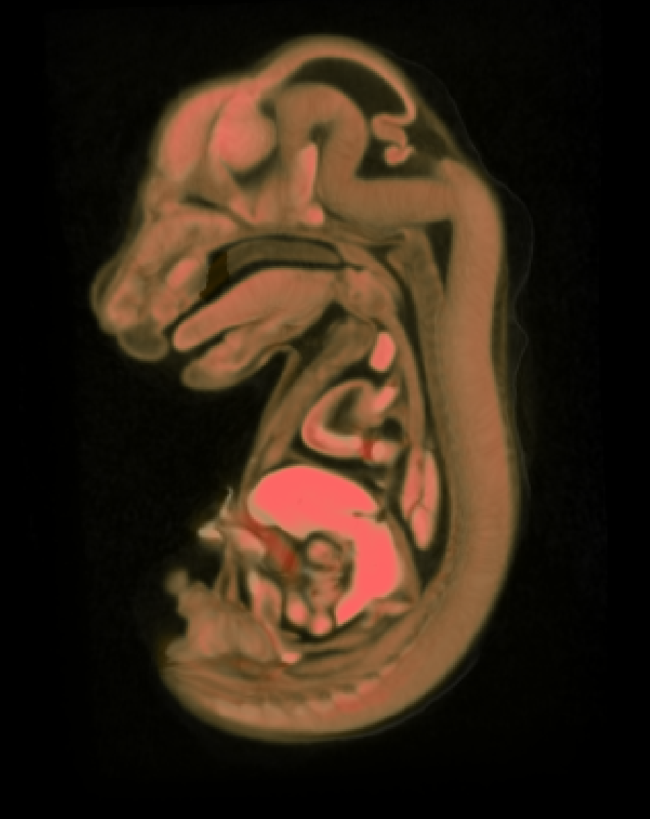
Image Registration: Transformation models
Target
Rigid Transformation
Affine Transformation
Deformable Registration
Moving
Rotation and translation only.
6 Degrees of Freedom (DOF) in movement
Rotation, translation, independent scaling and shearing on each axis
12 DOF
Every point can move
(within constraints)
Notes:
What I I presented to you so far, was the state of art about twenty years ago. Procrustes analysis continues to be used in the contexts where the expert knowledge is important (for understanding the anatomy or development) or in contexts where the throughput is not so important.
But because brain, unlike skull, is devoid of any meaningful amount of clear anatomical landmarks, in neurosciences these methods replaced by computationally driven, brute force methods in which entire images are used to assess differences. Correspondenses between two shapes are measured not by explicit framework like Procrustes analysis, but by measuring similarities in image intensities and geometry. This is the domain of medical image registration.
Here is three different types of commonly used image registration methods: You are looking at a cross-section of two mouse embryos, gray and red that are superimposed through different registration methods. Rigid is simply translation and rotation. As such the bulk size difference between these two embryos is still visible. Gray one is much bigger than the red one. The affine registration is still a linear registration, but unlike uniform scaling on all axes, affine allows independent scaling as well as shearing. In this case, it removed bulk of the size difference. It is a much nicer correspondence, yet still show difference in the hard, liver and ventrincles is visible. The last one is an elastic or non-linear deformation in which every voxel can move. At this level there is no discernable structural difference between these two embryos.

Slide 3
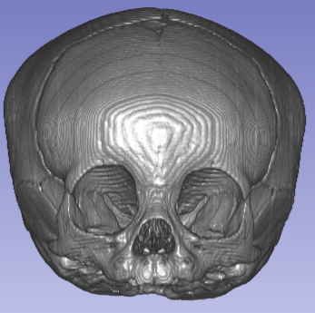
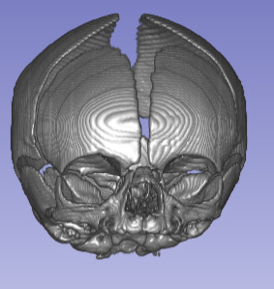
Image Registration: Similarity metric
Reference
Target
A
B

Slide 4
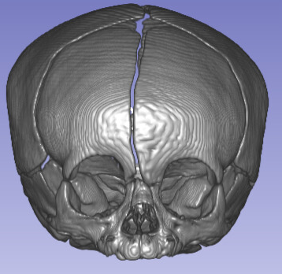
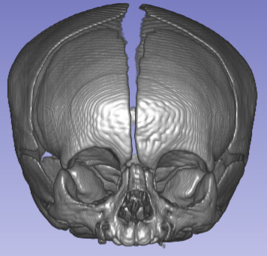
Image Registration: Similarity metric
Reference
Target
Similarity metric:
Demons
Similarity metric:
Cross-correlation
A
B

Slide 5
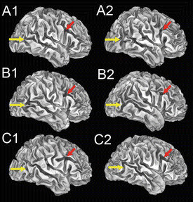
Folding variability in human cortex is
Van Essen DC, Donahue C, Dierker DL, et al. Parcellations and Connectivity Patterns in Human and Macaque Cerebral Cortex. 2016 Mar 11. In: Kennedy H, Van Essen DC, Christen Y, editors. Micro-, Meso- and Macro-Connectomics of the Brain [Internet]. Cham (CH): Springer; 2016. Available from: https://www.ncbi.nlm.nih.gov/books/NBK435771/ doi: 10.1007/978-3-319-27777-6_7
Three pairs of identical twins
(A1–2, B1–2, C1–2),

Slide 6
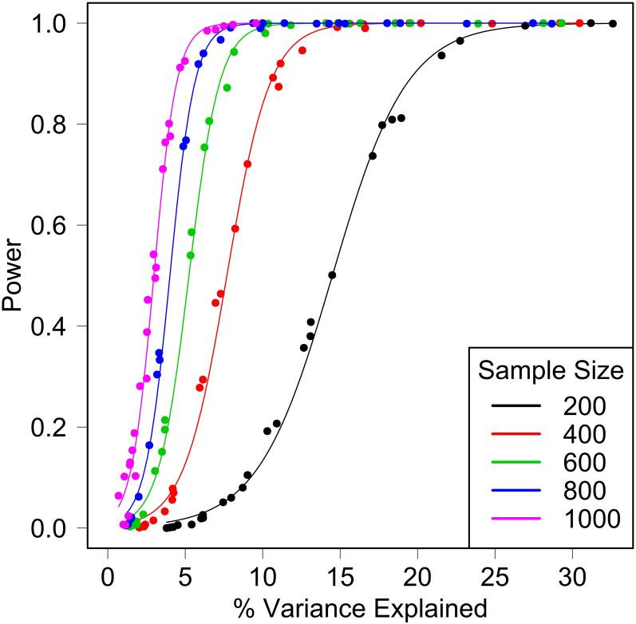
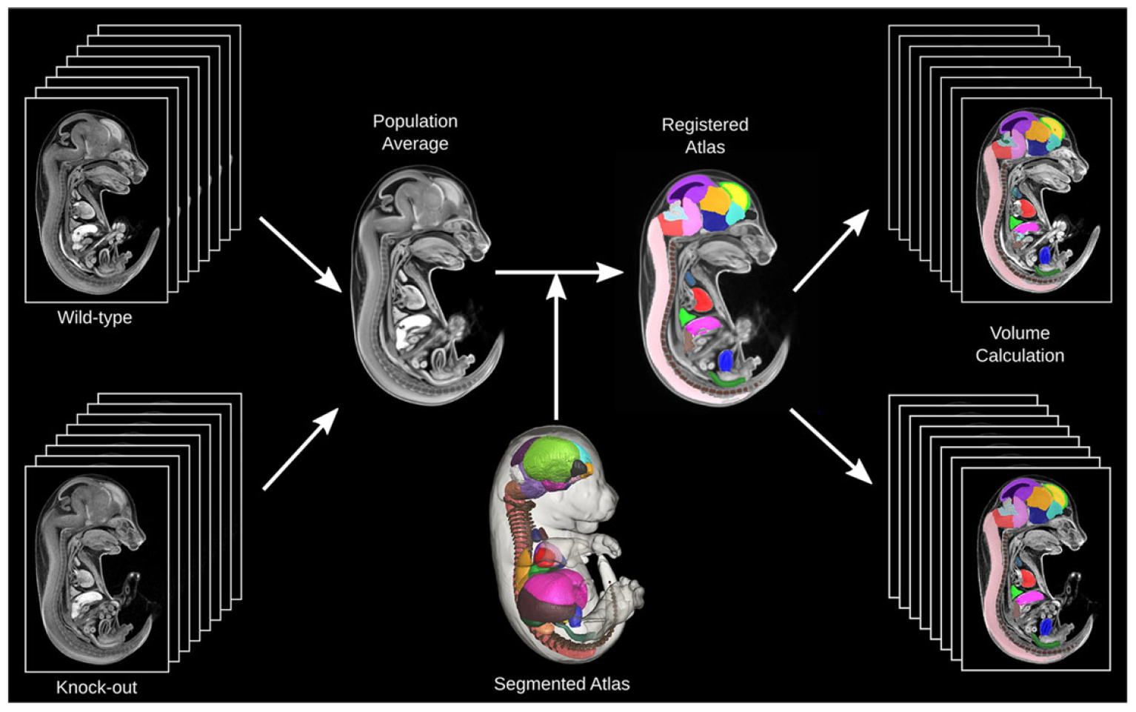
We might need large sample sizes
Gatti DM, Svenson KL, Shabalin A, Wu L-Y, Valdar W, Simecek P, Goodwin N, Cheng R, Pomp D, Palmer A, Chesler EJ, Broman KW, Churchill GA. 2014. Quantitative Trait Locus Mapping Methods for Diversity Outbred Mice. G3 4:1623–1633.

Slide 7
With standardization comes the throughput
Wong, M. D., Maezawa, Y., Lerch, J. P., and Henkelman, R. M. (2014). Automated pipeline for anatomical phenotyping of mouse embryos using micro-CT. Development.
Notes:
Similarities between genomic and imaging research:
3G BP whole-genome vs up to 1G voxel representation of 3D anatomy (1024x1024x1024 image volumes)
Memory and computational intensive. Registration of a single pair of 1G datasets (e.g. sample and template), would consume about 64-128GB of RAM even with single precision (float).
Most of those voxels are ‘uninformative’ (i.e. they contain either empty space, or if they are describing deformation fields, where there is none)
We can mask the anatomy to reduce the computational burden (e.g. extract a smaller region within a brain, or if we are looking at skull, isolate bone only regions, that’s an 1-2 order of magnitude reduction in the size of the data).
One benefit we have over genomic approaches is we can downsample to speed up the process while designing the computational pipeline. For example most adult patient CT scans for skulls are acquired at ~0.5mm resolution (512x512x512). We can subsample to 1mm or even higher resolution (which would reduce dataset 8-16 folds), which would preserve the geometry at that scale. We can design a flow based on reduced dataset, sort out the issues, measure the effect at that scale, and repeat the whole process for the full resolution images (to look at finer detail). This also gives us a baseline to compare the full-resolution results.
A template is used to register the samples against, calculate the deformation necessary to warp the sample into template, and apply statistics on this new volume which describes the deformation field (A deformation field is 3 times as big as the original volume. I.e a 1G voxel dataset, would need 3G voxel dataset to describe the necessary deformation, as there is an X, Y, Z component to each deformation.)

Slide 8
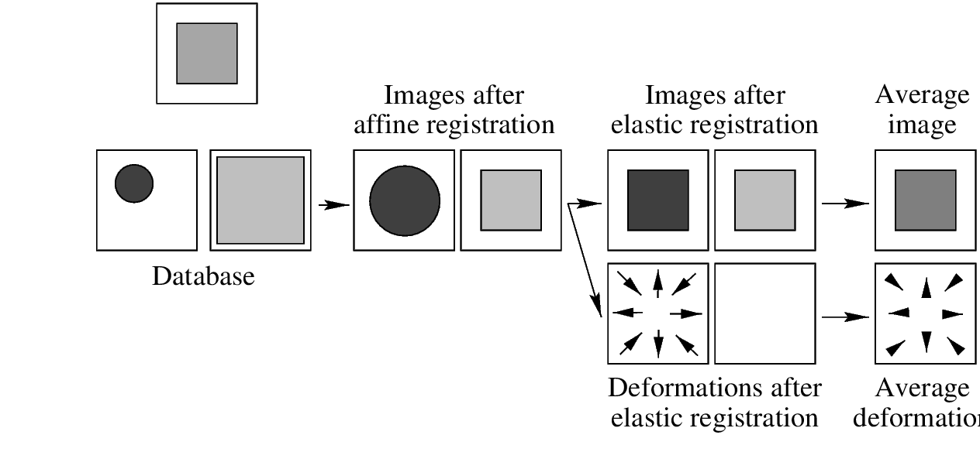
Atlas Building
The atlas construction framework iteratively finds a virtual space which resides in the centroid of the population (i.e. deformations needed to transform all subjects into this virtual space sum up to zero everywhere in this virtual space)
Reference
Targets
(Subjects)
Guimond, A, Jean M, & Thirion JP. "Average brain models: A convergence study." Computer vision and image understanding 77, no. 2 (2000): 192-210.
Notes:
We can use affine and deformable registration to construct a study or population template (also called an example).
Here is an conceptual example in which two targets, a small circle and a large square is registered to a reference).

Slide 9
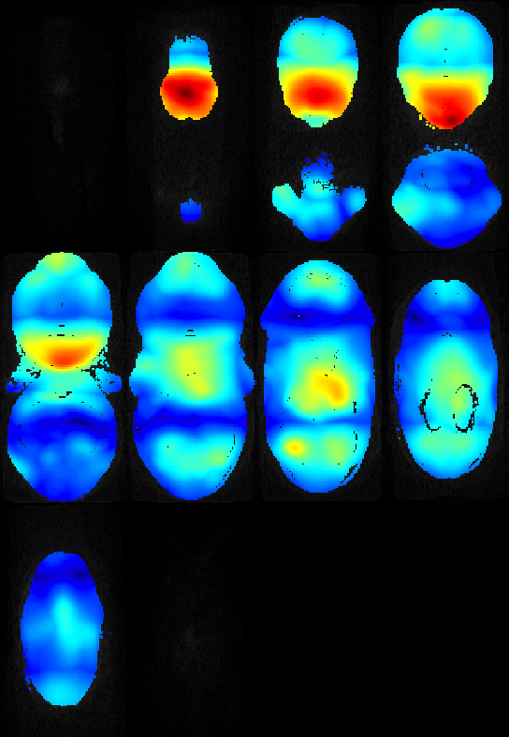
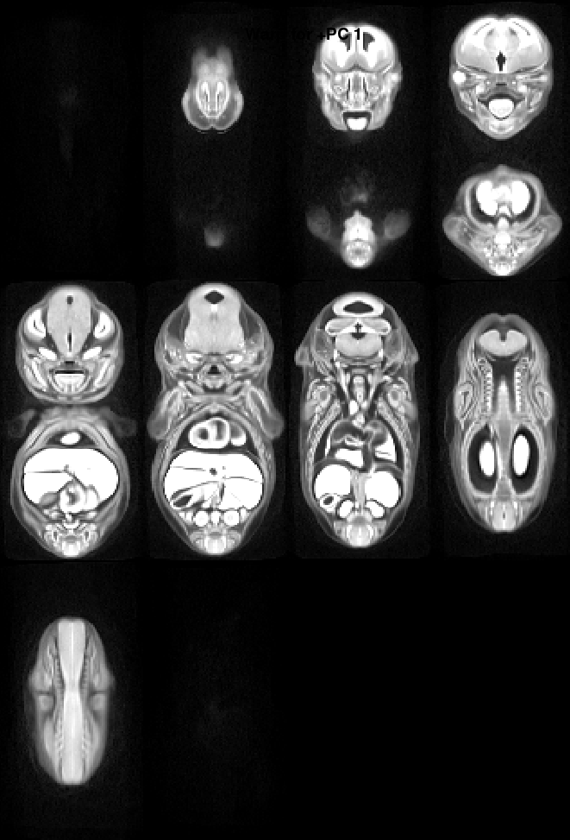
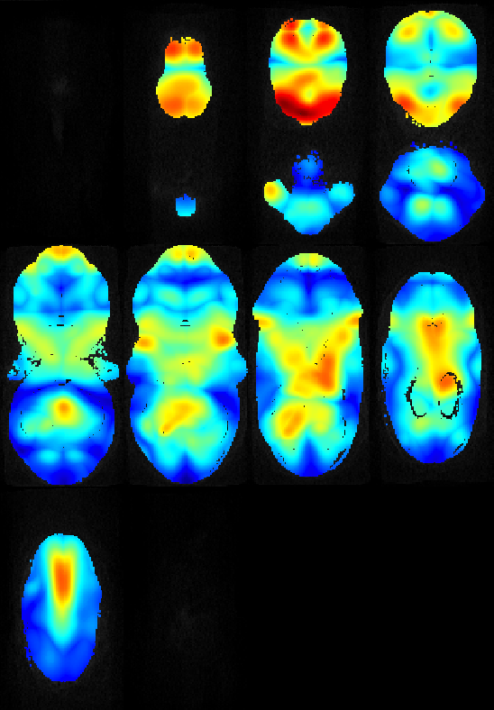
PCA as a tool for exploratory analysis in mouse screens
Fetal Alcohol Exposure Induced Developmental Variability
Control mice fetuses at E15
Study template
(Population average)
E15 fetuses from dams consumed 10% v/v EtOH ad-libidum during the first 8 days of pregnancy (E0-E8)
Maga lab unpublished data (undergrad project)

Slide 10
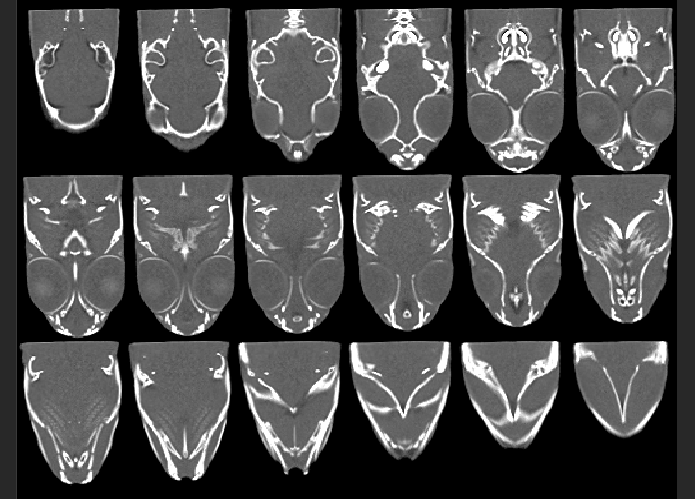
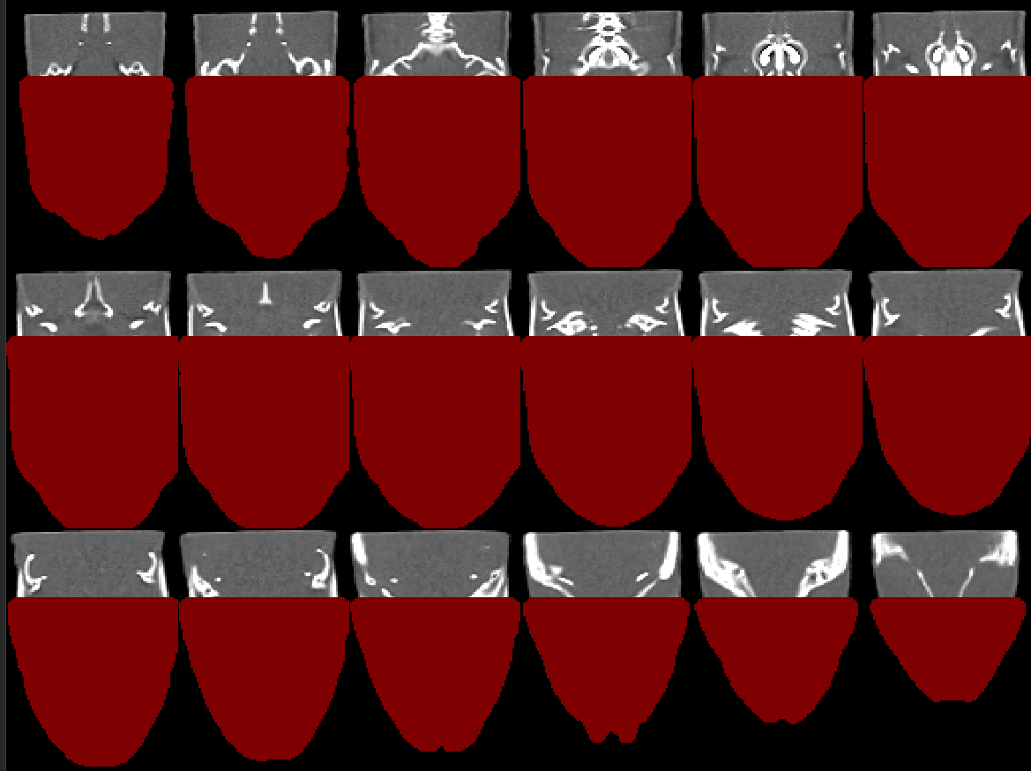
Zebrafish skull template
Data from Ronald Kwon, MicroCT-based phenomics in the zebrafish skeleton reveals virtues of deep phenotyping in a distributed organ system. eLife. https://elifesciences.org/articles/26014 (this is all on PC skeleton).

Slide 11
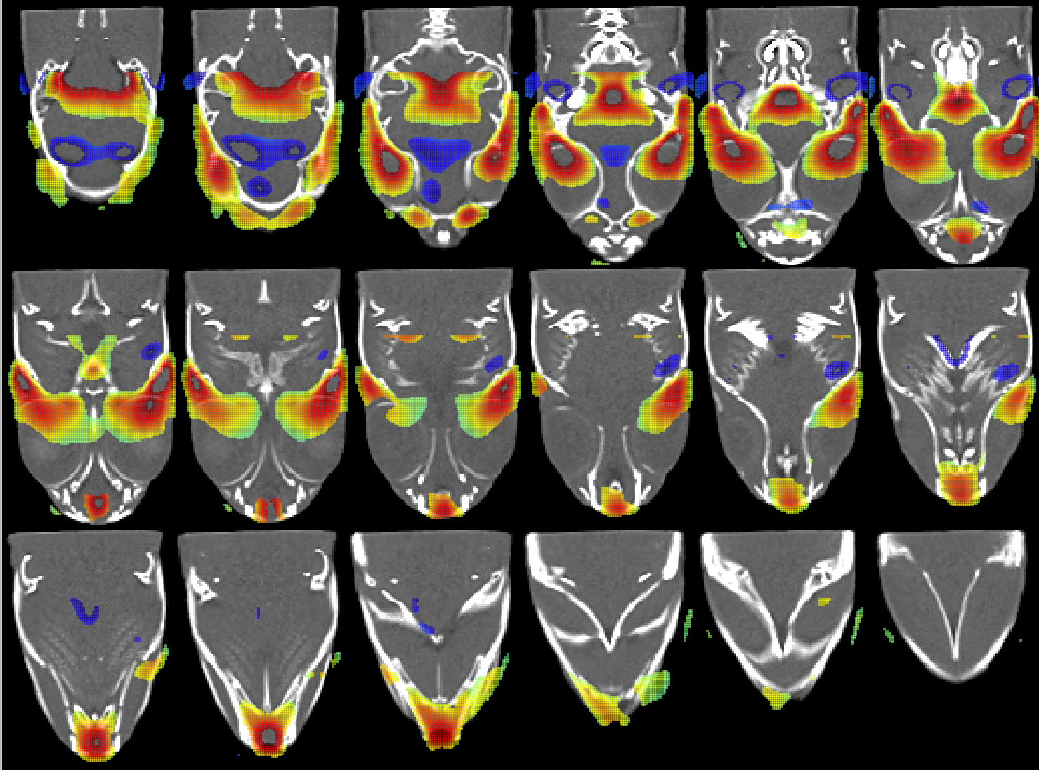
Littermates vs bmp1a mutants growth differences
Warmer colors, regions significantly shrunk in mutants compared to littermates
Colder colors, regions significantly enlarged in mutants compared to littermates
Bhimani RM, Watson CJ, Maga AM, Kwon RY. 2019. FishCuTv2: An Extensible Software for microCT-Based Whole-Body Skeletal Phenomics in Zebrafish. Annual Meeting of Orthopaedic Research Society. Austin, TX

Slide 12
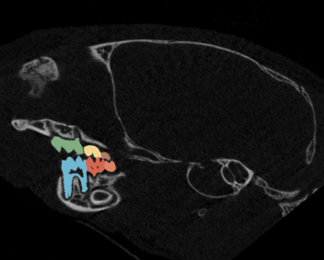
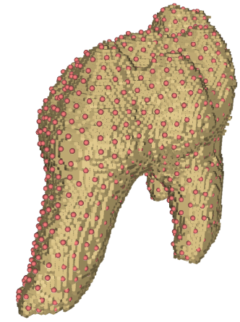
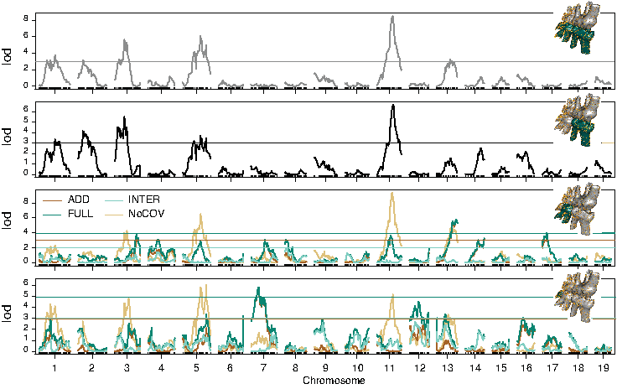
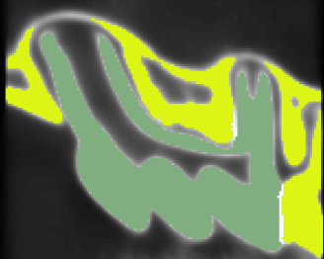
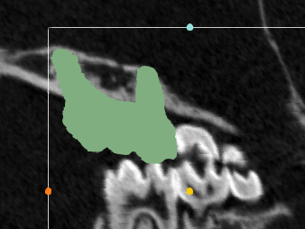
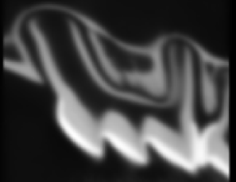
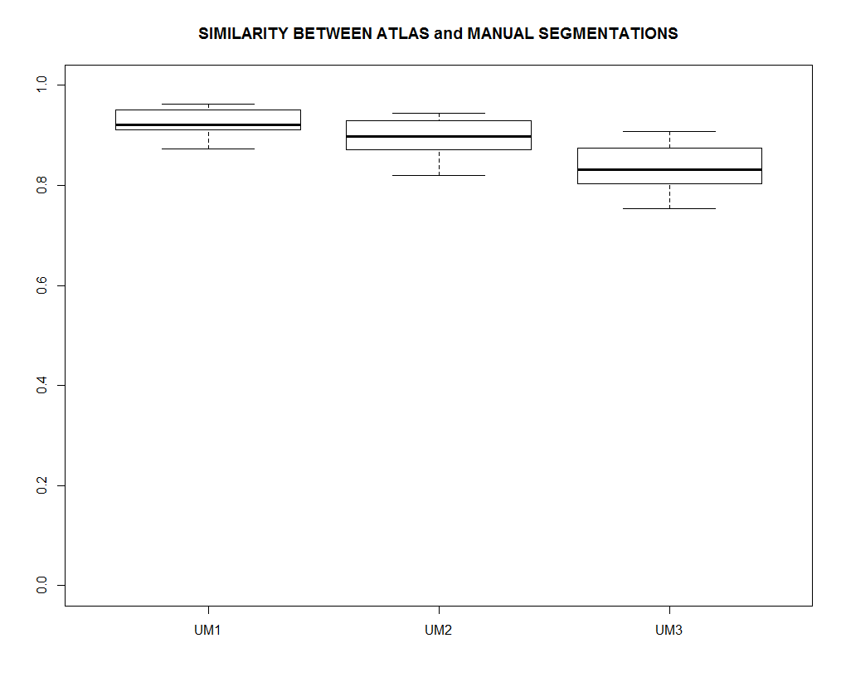
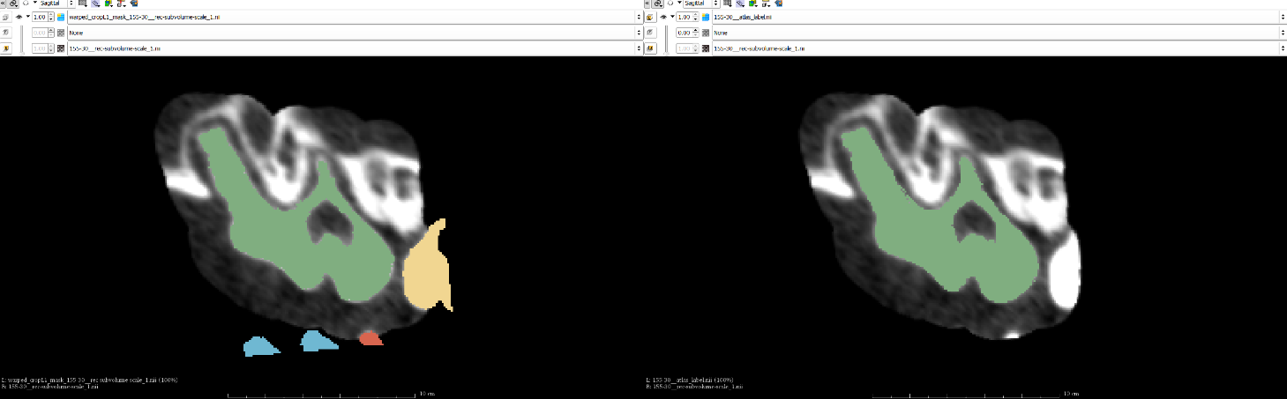

Genetic control of 3D molar size
Initial segmentation
Segment Atlas
Transfer and Mask
Indiv. Atlases for molars
Atlas Validation
Pipeline for automated segmentation of ~2500 molars from more than 400 mouse scans
1.0
0.8
0.6
Similarity Score
Navarro N, Maga AM. 2018. Genetic mapping of molar size relations identifies inhibitory locus for third molars in mice. Heredity 121:1–11.
0.4
0.2
0.0
Manual
Atlas-Based

Slide 13
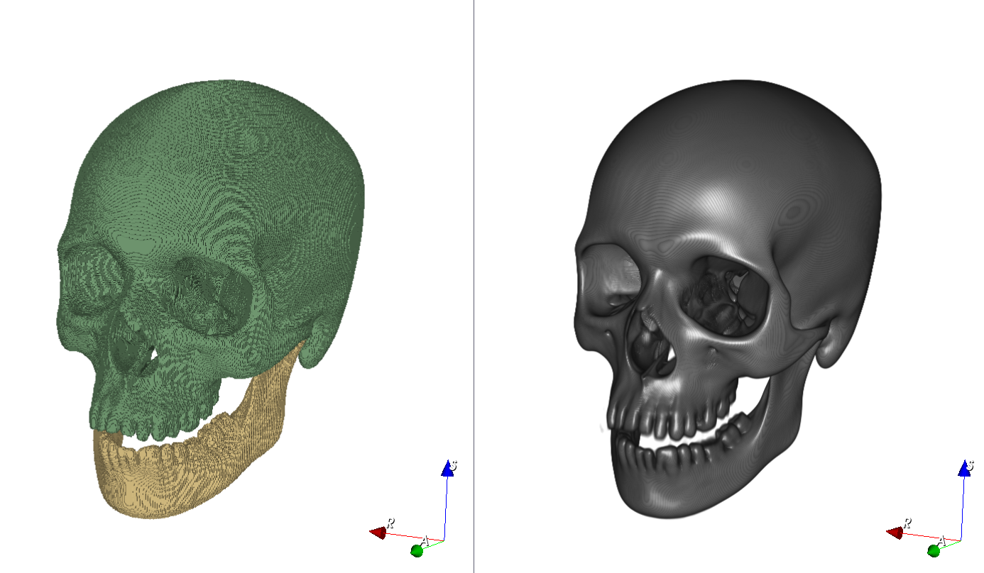
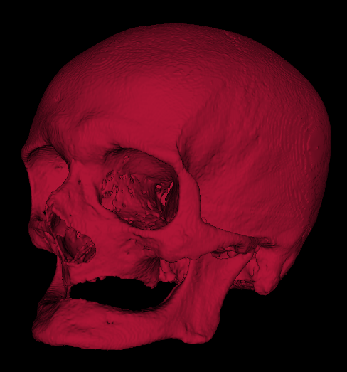
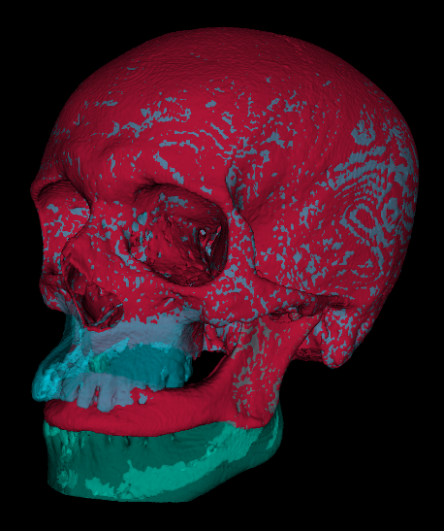
Population atlas based segmentation
Skull templates for Homo sapiens
Data curtesy of Dr. Lynn Copes: Smithsonian Terry Collection. https://www.lynncopes.com/human-ct-scans.html
Notes:
We are also working on achieving the same for clinical data. On the right is a synthetic template of adult human skull based on 86 CT scans of skeletal remains from Terry Collection (they are mixed ancestry, mixed sex from 20-80 years of age). On the left is the segmentation of skull and mandible.

Slide 14

Single template captures limited amount of population variability
Rohlfing et al. - 2005 - Quo Vadis, Atlas-Based Segmentation
Rohlfing T, Brandt R, Maurer Jr CR, Menzel R. 2001. Bee brains, B-splines and computational democracy: generating an average shape atlas. In: IEEE Workshop on Mathematical Methods in Biomedical Image Analysis, 2001. MMBIA 2001. . p 187–194.
Notes:
It was clear that while the rest of the skull perfectly fit to the template, midface and the mandible did not. Clearly the phenotypic variation in the dataset is much too high to deal with a single 20-80 year range template and probably need to split this into two age groups to achieve better segmentation of skull and mandible.

Slide 15
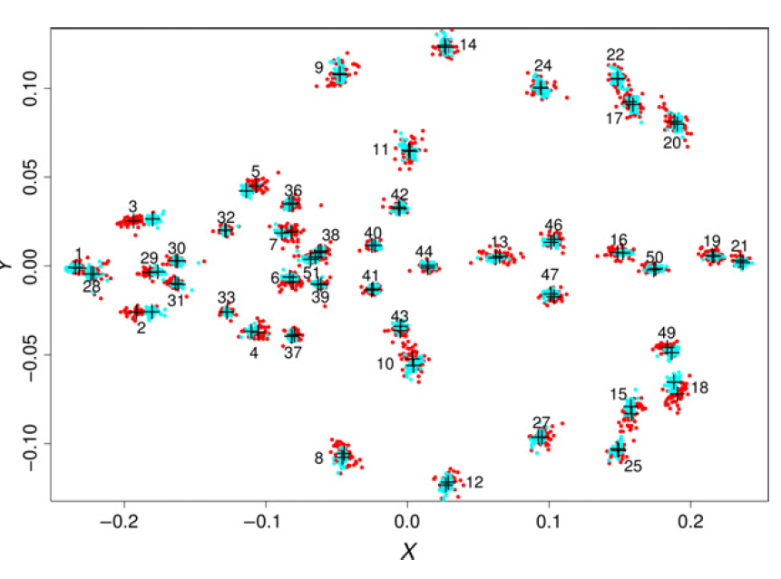
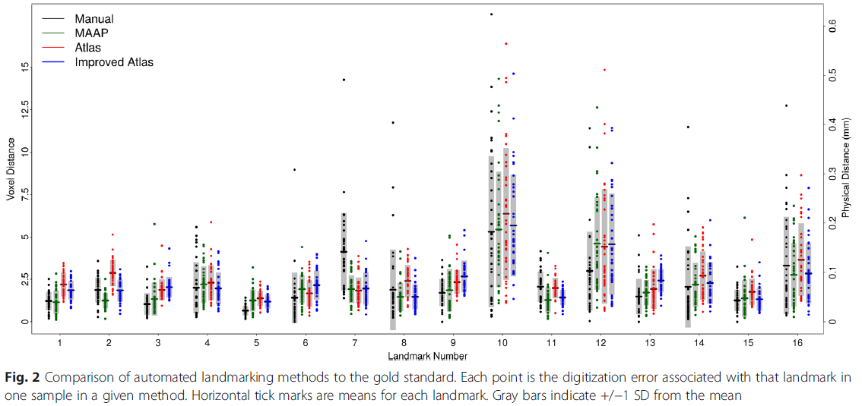
‘almost’ fully-automated landmarking
Maga AM, Tustison NJ, Avants BB. 2017. A population level atlas of Mus musculus craniofacial skeleton and automated image-based shape analysis. Journal of Anatomy 231:433–443.
Young R, Maga AM. 2015. Performance of single and multi-atlas based automated landmarking methods compared to expert annotations in volumetric microCT datasets of mouse mandibles. Frontiers in Zoology 12:33.

Slide 16
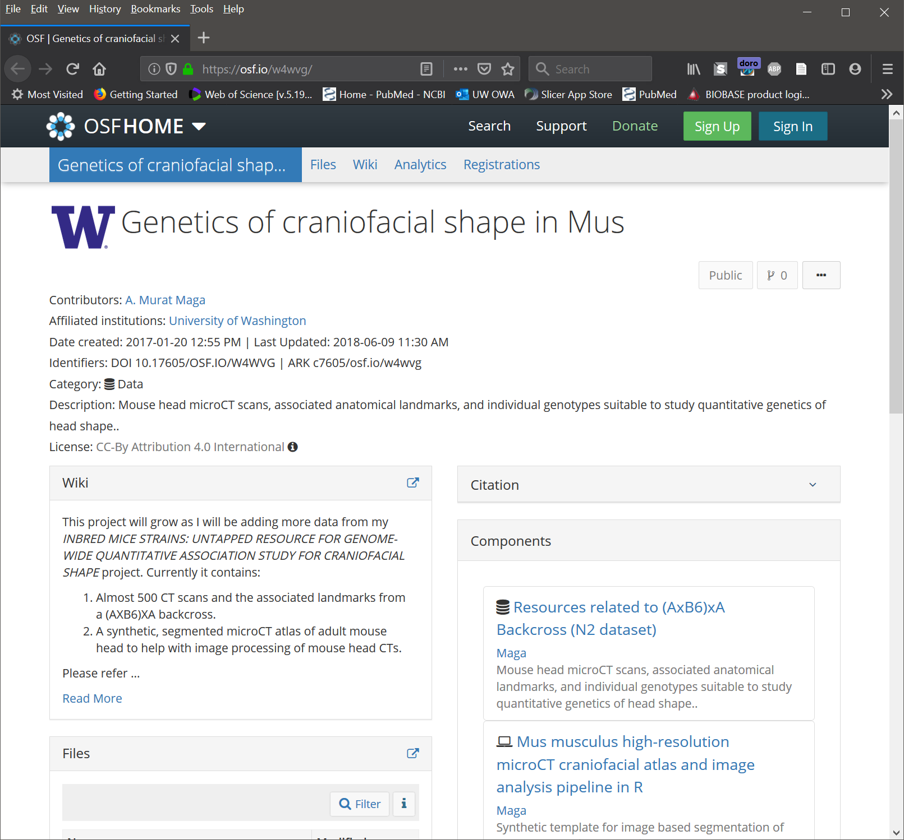
Genetics of craniofacial shape in Mus https://osf.io/w4wvg
~500 mouse skull microCT scans
433 of them genotyped
All samples PN28,
35 micron isotropic voxel resolution
Associated cranial landmarks (mandible also)
cross data (sex, weight, genotype, pedigree)
All can be directly loaded and visualized in 3D Slicer.
And data can be analyzed with SlicerMorph
Datasets publicly available with Creative Commons by attribution license.

Slide 17
Other Morphometrics

Slide 18
PCA as a tool for exploratory analysis in mouse screens
Fetal Alcohol Exposure Induced Developmental Variability
Control mice fetuses at E15
Study template
(Population average)
E15 fetuses from dams consumed 10% v/v EtOH ad-libidum during the first 8 days of pregnancy (E0-E8)
Maga lab unpublished data (undergrad project)

Slide 19
Zebrafish skull template
Data from Ronald Kwon, MicroCT-based phenomics in the zebrafish skeleton reveals virtues of deep phenotyping in a distributed organ system. eLife. https://elifesciences.org/articles/26014 (this is all on PC skeleton).

Slide 20
Littermates vs bmp1a mutants growth differences
Warmer colors, regions significantly shrunk in mutants compared to littermates
Colder colors, regions significantly enlarged in mutants compared to littermates
Bhimani RM, Watson CJ, Maga AM, Kwon RY. 2019. FishCuTv2: An Extensible Software for microCT-Based Whole-Body Skeletal Phenomics in Zebrafish. Annual Meeting of Orthopaedic Research Society. Austin, TX

Slide 21
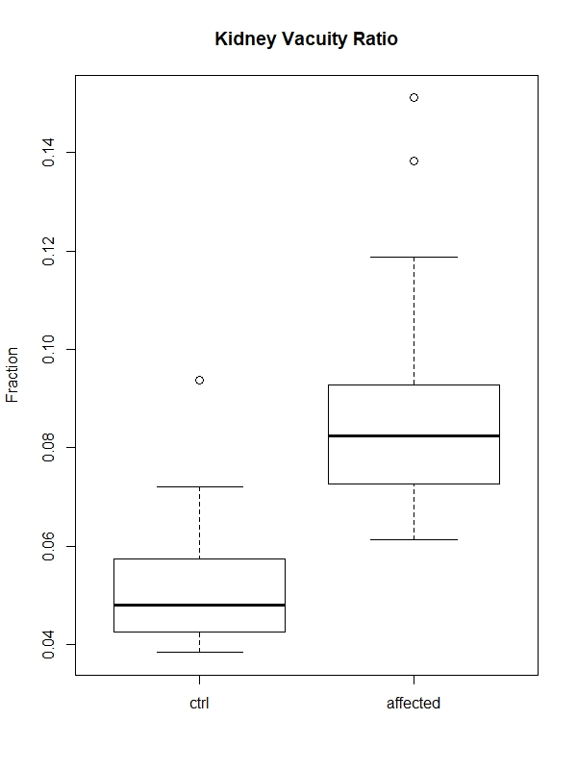
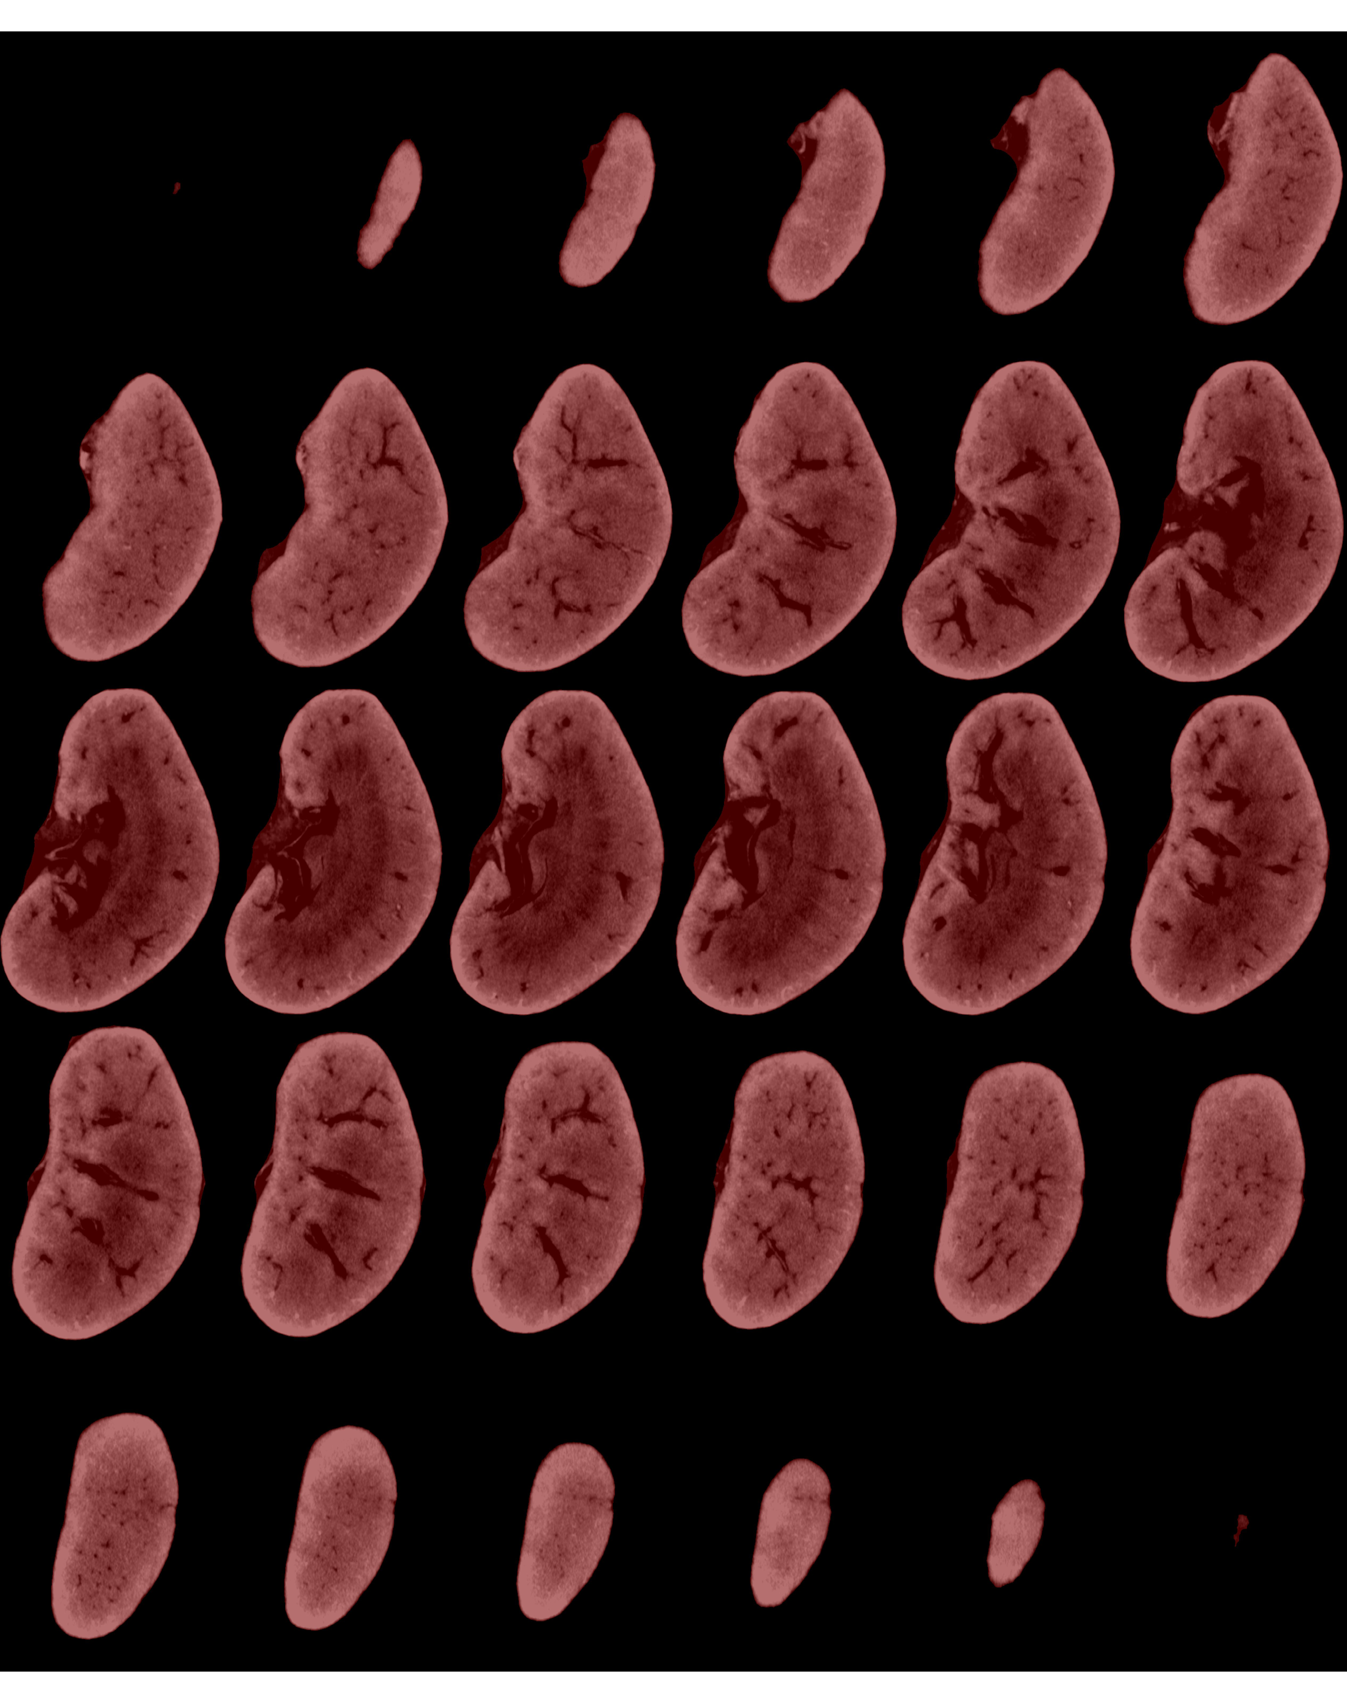
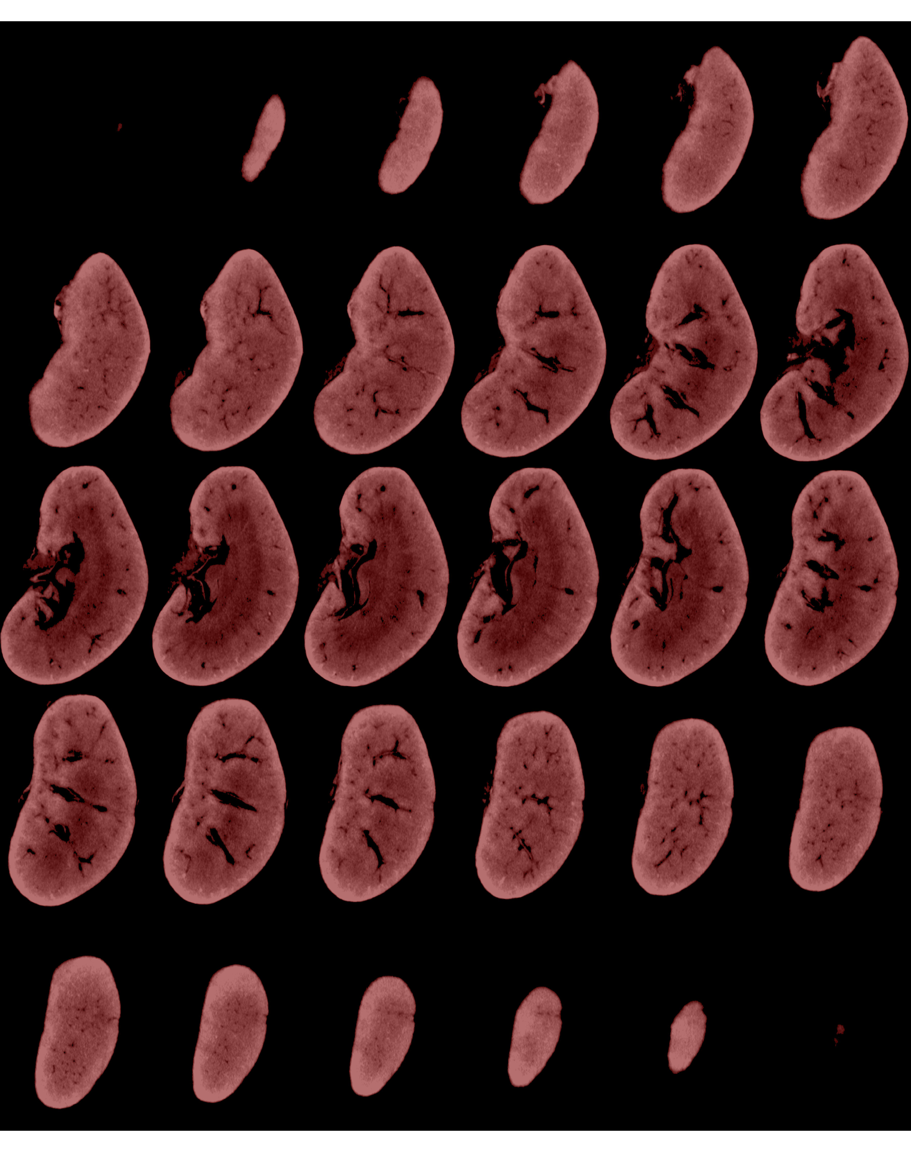
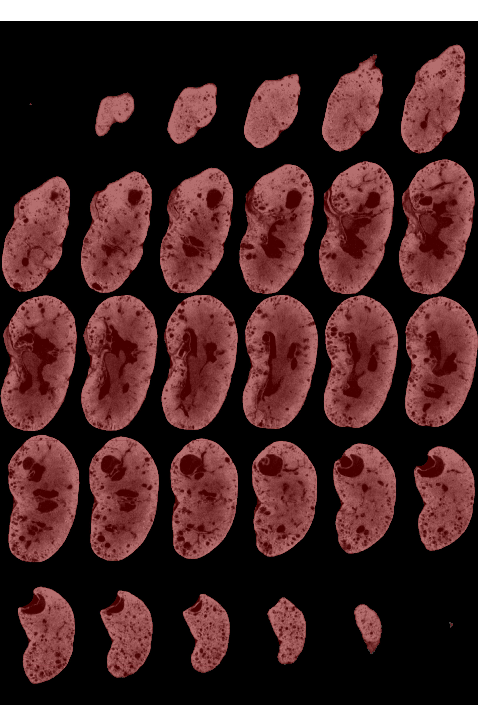
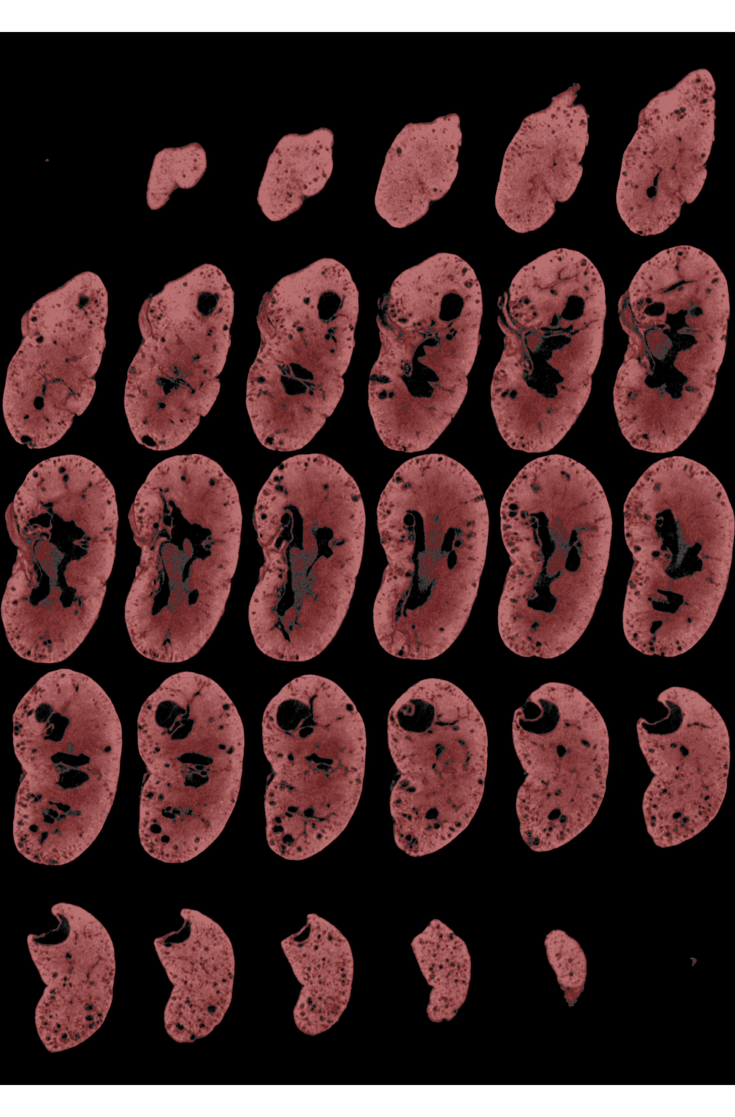
Mouse Model of Polycystic Kidney Disease
Total Kidney Volume
Kidney Tissue Volume
Unaffected littermate
PKD Mutant
Screening for modifiers of PKD severity
using ENU mutagenesis (R01DK111682 , PI: Beier)

Slide 22
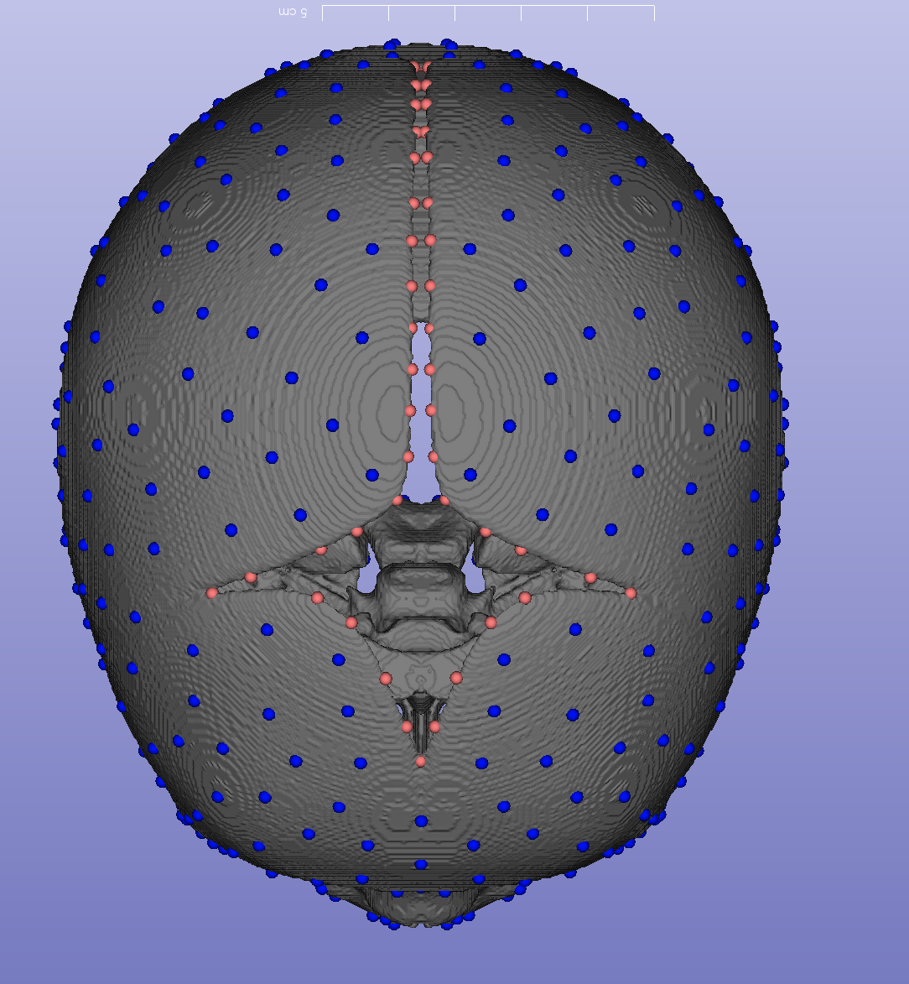
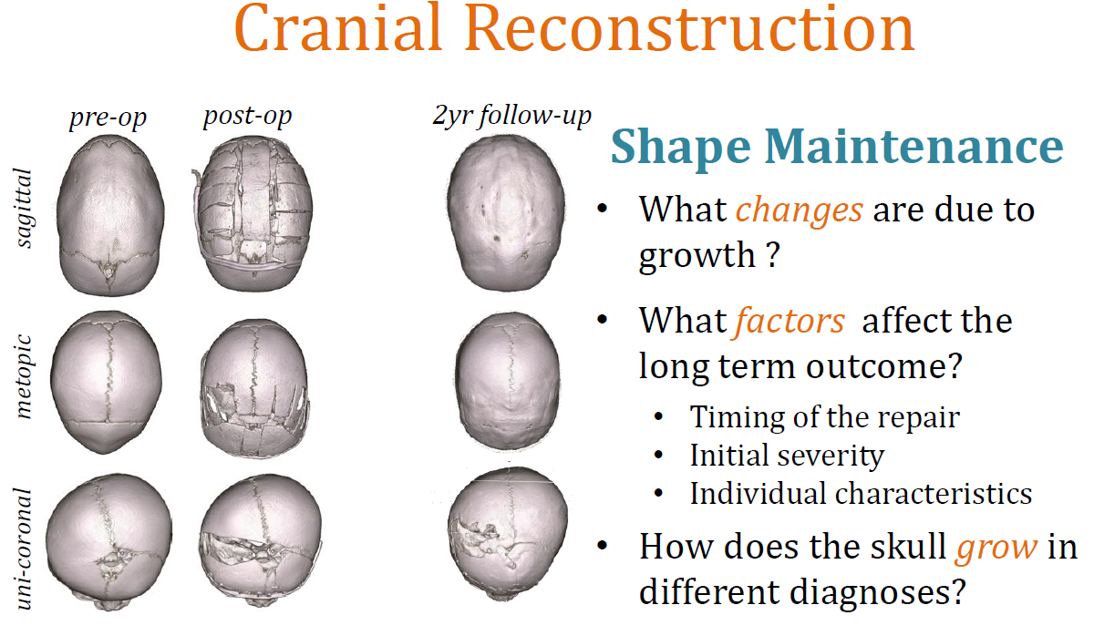
Clinical application: Skull growth in craniosynostosis

Slide 23
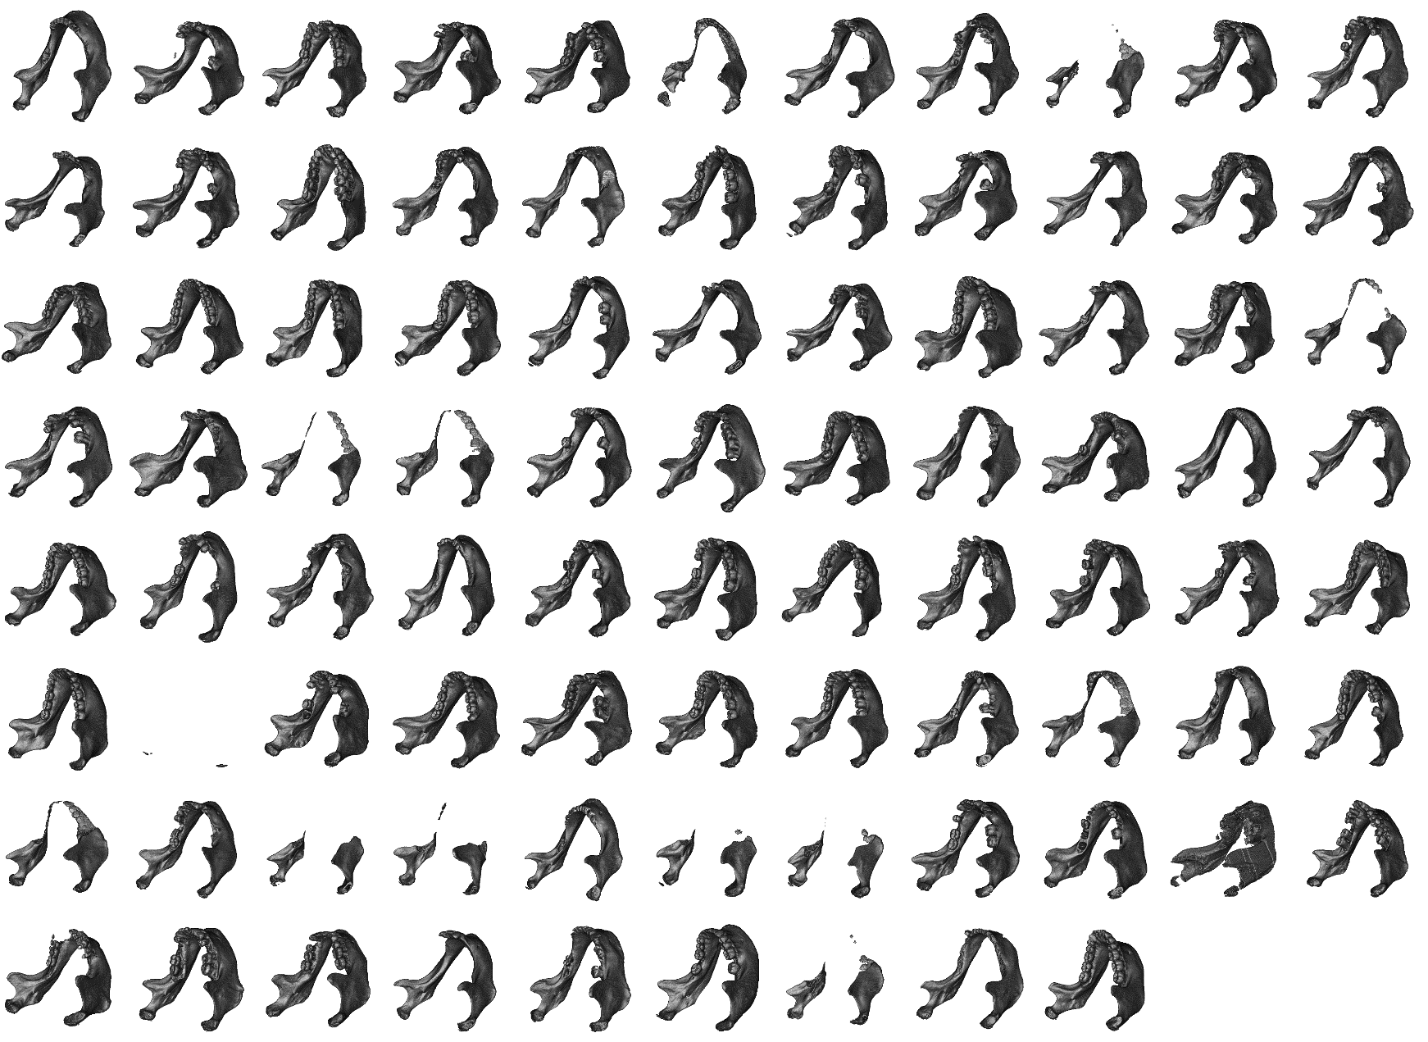
Segmenting Mandibles from Clinical CT
Notes:
We warped these segmentations back to original samples and isolate the mandibles. It worked about 75% of the population. I looked more closely at the samples why they failed.

Slide 24
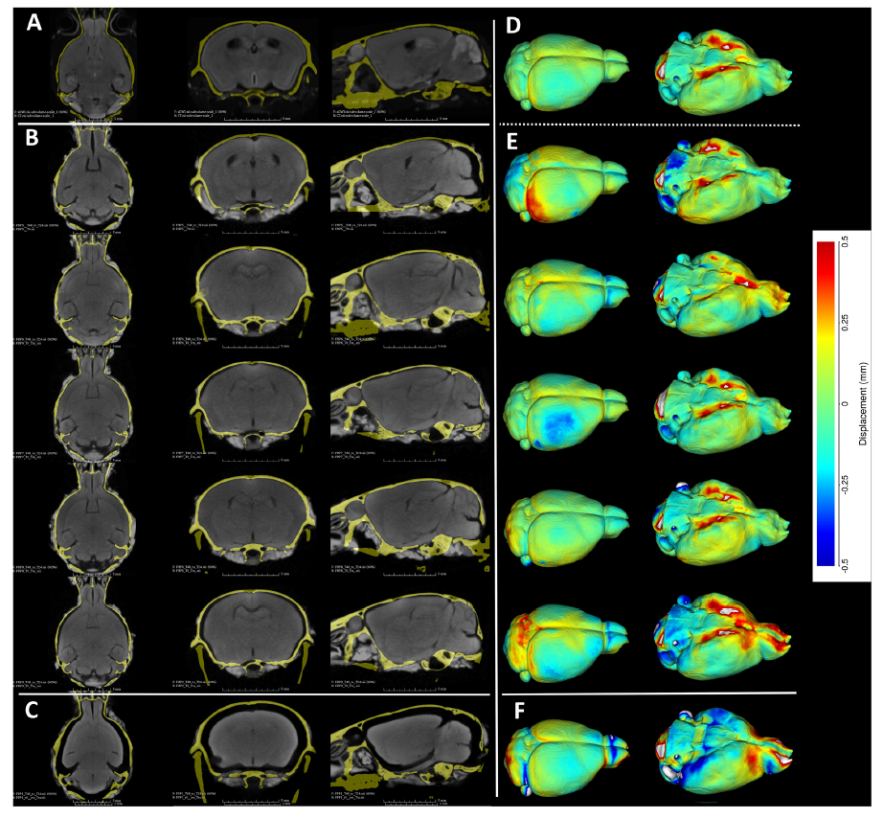
Diffusible Iodine Contrast Enhanced (dice) CT
MRI
diceCT
Anderson, R., and Maga, A. M. (2015). A Novel Procedure for Rapid Imaging of Adult Mouse Brains with MicroCT Using Iodine-Based Contrast. PLoS ONE

Slide 25
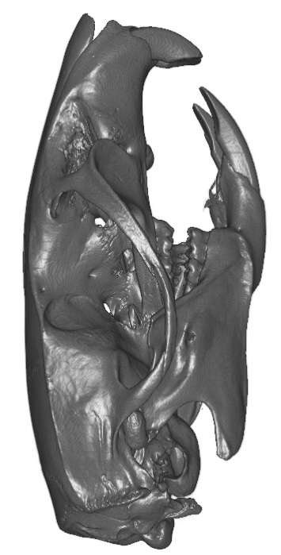
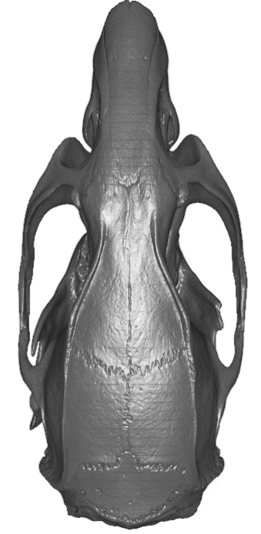
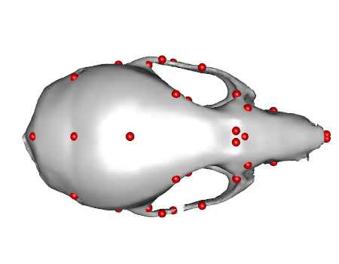
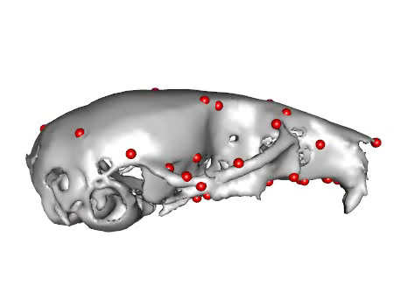
Effect of organismal size on shape
Notes:
…I think they begin to look like rats….
So, whatever the developmental processes resulting in the adult mouse skulls, it is very similar for Rattus, but it happens to go on longer, resulting in a bigger organism.
I don’t have enough Rat skulls to measure that right now, but I would wager that they almost would be on the same size / skull scaling regression of Mus.
Keep in mind that Rat/Mus divergence is about 20 MYA, at the same scale if not older than human/chimpanzee split.

Slide 26
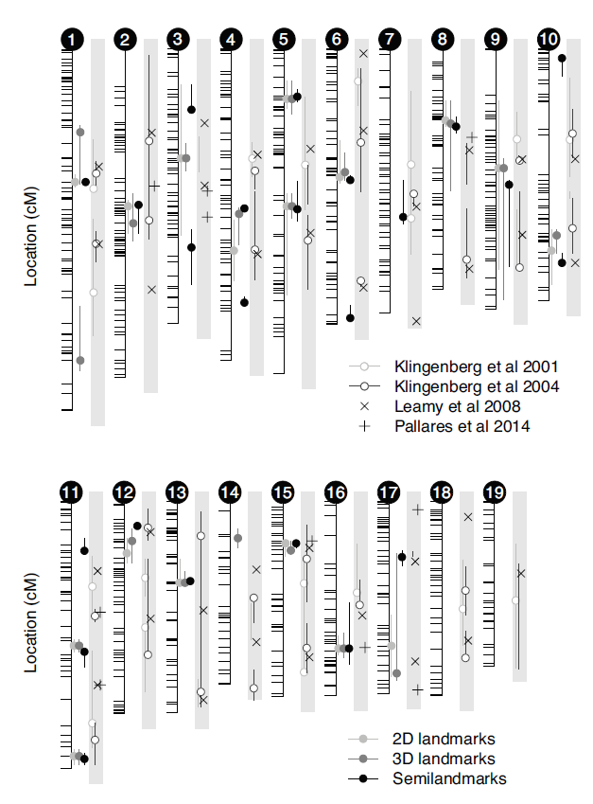
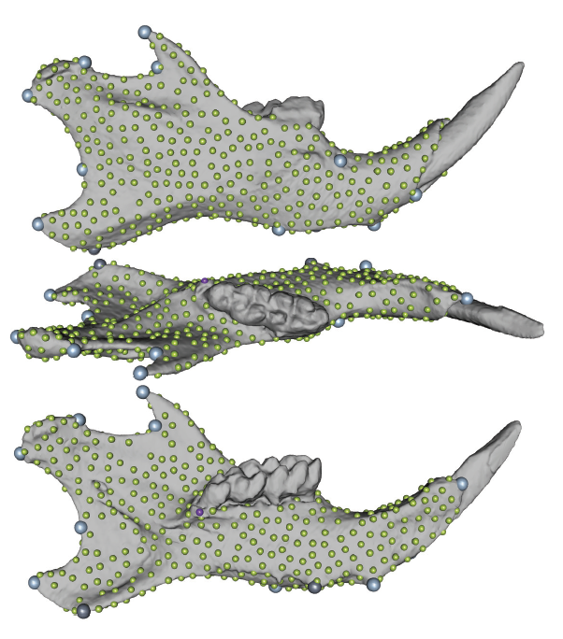
Phenotyping matters in mapping
Navarro, N., and Maga, A. M. (2016). Does 3D Phenotyping Yield Substantial Insights in the Genetics of the Mouse Mandible Shape? Genes|Genomes|Genetics.
Notes:
We used the same cross, to do a very simple experiment. What do we gain (or lose) in terms of mapping accuracy if we use different types of phenotyping. One thing to note is that mouse hemi-mandibles are fairly flat with a minimal Z dimension.
So what we did is we phenotype them with standard set of mandibular landmarks (gray spheres) in 3D. We then projected these landmarks into 2D, as if we have taken a picture of them laying flat on a camera stand, and finally we used lots of geometrically equivalent landmarks (little green spheres). All statistical models, genotyping everything is the same except what we get out of our shape analyses. So in the end, what we saw while there was almost no difference between 2D and 3D landmarks, we obtained for more loci, with better precision (confidence intervals were shorter) when we used dense modeling.

Slide 27
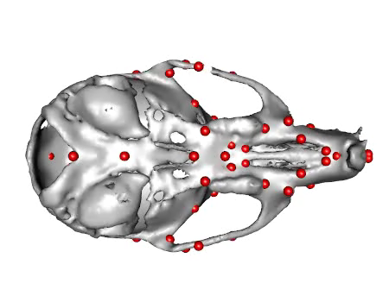

Slide 28

Qualitative results: Brain Dysmorphologies
Notes:
Small head, small eyes all consistent with FAS.

Slide 29

Deformable Image Registration

Slide 30

Optical Projection Tomography
Notes:
OPT shares many similarites with mCT, rotational stage, a CCD. In transmission mode, photons are projected through the specimen from a light source on side and captured by CCD on the other.
The major difference from mCT is the fact that optical lenses are used to create a focused image of the specimen, as oppose to capturing a shadow as in mCT.
That;s the major nuisance of OPT, lenses mean limited depth of focus, which usually cannot emcompass the whole specimen.
Fluroscence mode:

Slide 31


Images are courtesy of Dr. Timothy Cox (SCRI, SANTA facility)
Notes:
The ‘yellow’ mouse embryo is a lacZ reporter gene also

Slide 32



Images are courtesy of Dr. Timothy Cox (SCRI, SANTA facility)
Notes:
There are four axolotl embryo images - whole mount immunohistochemistry. The two ‘dorsal view’ images are the same view just with or without the white light channel (black) rendered. The image showing the rear view of the axolotl shows all the different channels - UV (autofluorescence) for surface, UV filter for IHC, and white/IR light for pigment. The other images are IHC processed tissue: mouse embryonic lungs

Slide 33
We need high sample sizes

Slide 34


Landmarks are investigator specific!
Percival CJ, Green R, Marcucio R, Hallgrímsson B. 2014. Surface landmark quantification of embryonic mouse craniofacial morphogenesis. BMC Developmental Biology 14:31.

Slide 35





Or your student not paying attention!

Slide 36
Image-based analysis (registration & segmentation)
Maga AM, Tustison NJ, Avants BB. 2017. A population level atlas of Mus musculus craniofacial skeleton and automated image-based shape analysis. Journal of Anatomy 231:433–443.

Slide 37
Atlas-based Landmarking
Turn the question into a segmentation task:
0. Create a population average (atlas) from your sample (you can skip this step if you have an existing atlas –but more on this later).
1. Landmark the atlas
2. Use deformable registration to warp atlas to every sample.
3. Use the resultant warp field to move atlas landmarks onto each sample
But how do you know it worked? (Validation step)

Slide 38
Atlas-based LM’ing of mouse skull
Maga, A. Murat, Nicholas J Tustison, and Brian B Avants. “A Population Level Atlas of Mus Musculus Craniofacial Skeleton and Automated Image-Based Shape Analysis.” Journal of Anatomy 231, no. 3 (2017): 433–43. https://doi.org/10.1111/joa.12645.

Slide 39



Automated pipeline for mouse head microCTs
https://github.com/muratmaga/mouse_CT_atlas/

Slide 40

Multi Atlas Segmentation
Label Fusion step gives us the probabilities
Majority vote
Warfield SK, Zou KH, Wells WM. 2004. Simultaneous truth and performance level estimation (STAPLE): an algorithm for the validation of image segmentation. Medical Imaging, IEEE Transactions on 23:903–921.
Rohlfing T, Maurer Jr CR. 2007. Shape-Based Averaging. IEEE Transactions on Image Processing 16:153–161.
Jimit Doshi, Guray Erus, Yangming Ou, Bilwaj Gaonkar, Christos Davatzikos. Multi-Atlas Skull-Stripping, MASS. Academic Radiology

Slide 41

Atlas-based automatic landmarking
Young, Ryan, and A. M. Maga. “Performance of Single and Multi-Atlas Based Automated Landmarking Methods Compared to Expert Annotations in Volumetric MicroCT Datasets of Mouse Mandibles.” Frontiers in Zoology 12, no. 1 (December 1, 2015): 33. https://doi.org/10.1186/s12983-015-0127-8.

Slide 42


Problematic Landmark Detection
Calculate the landmark location from each selected template
If the distance between the final landmark location and any two template landmarks exceeds a threshold flag as problematic
Reliable Landmark
Potentially problematic landmark

Slide 43

Outlier detection is important
Young, Ryan, and A. M. Maga. “Performance of Single and Multi-Atlas Based Automated Landmarking Methods Compared to Expert Annotations in Volumetric MicroCT Datasets of Mouse Mandibles.” Frontiers in Zoology 12, no. 1 (December 1, 2015): 33. https://doi.org/10.1186/s12983-015-0127-8.

Slide 44
Ups and downs of multi-atlas based methods
Template selection is a critical step. You have to somehow analyze your data first to pick your templates.
If you have picked N templates, then you have N*sample size pairwise registration jobs.

